Slide 1
On Demand Real Time Reporting System
Mojo Americas

Slide 2
About Mojo
Mojo Americas is a web based application that allows our customers to track order processing, allighning team with accountblity. It provide the traceability of documents from Sales, Engineering Dispatch to Collection from single platform on single click. Customer view all certificate and supportive documents of each order online 24/7/365. Mojo Americas helps organizations to reduce the inefficiencies, risks and costs
associated with managing their information.
“Order to collection” management
control system.

Slide 3
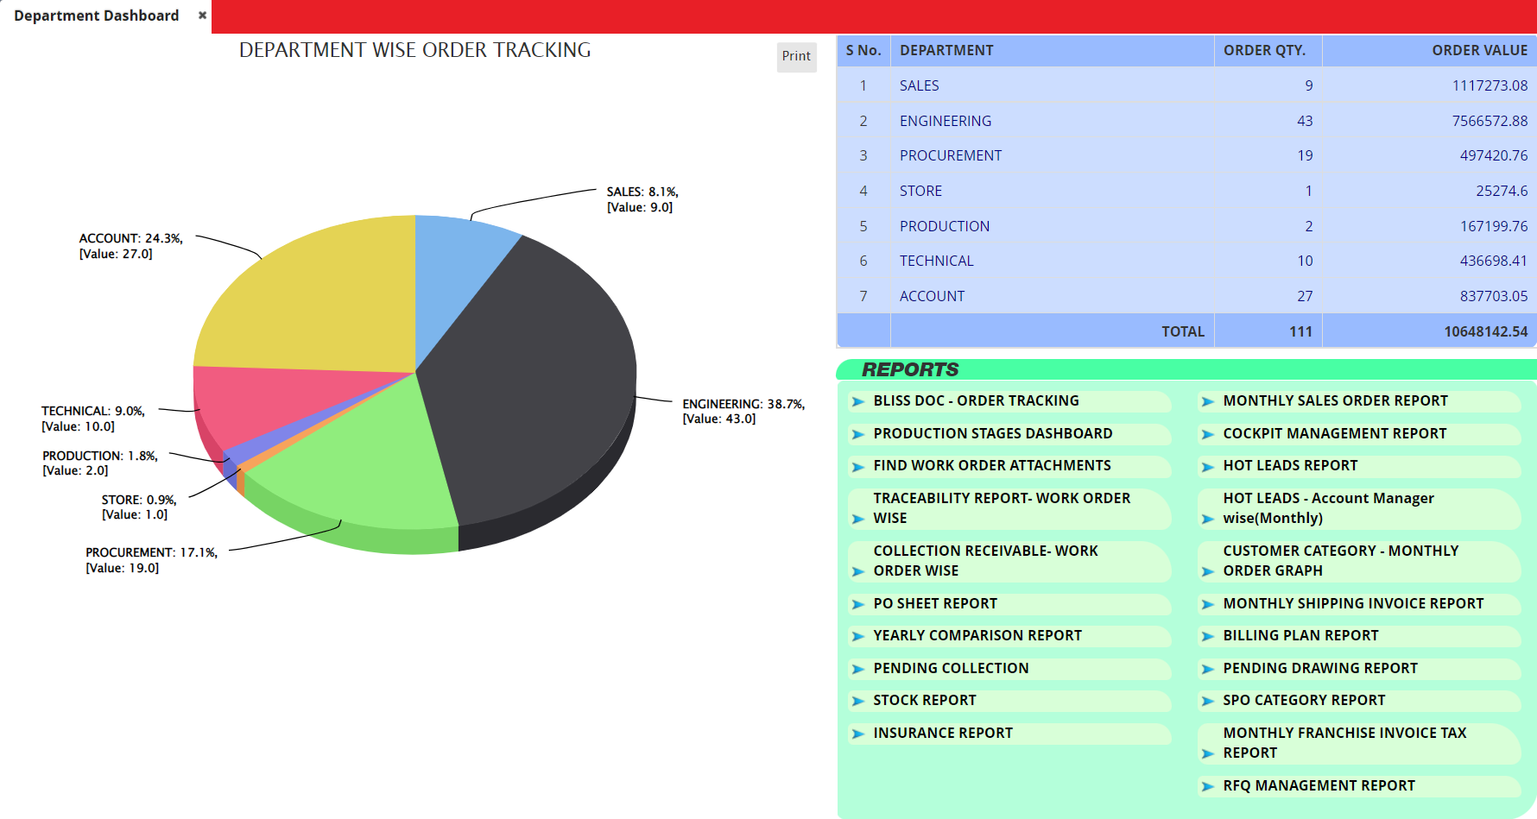
Dashboard of Mojo Screen
www.mojoamericas.com

Slide 4
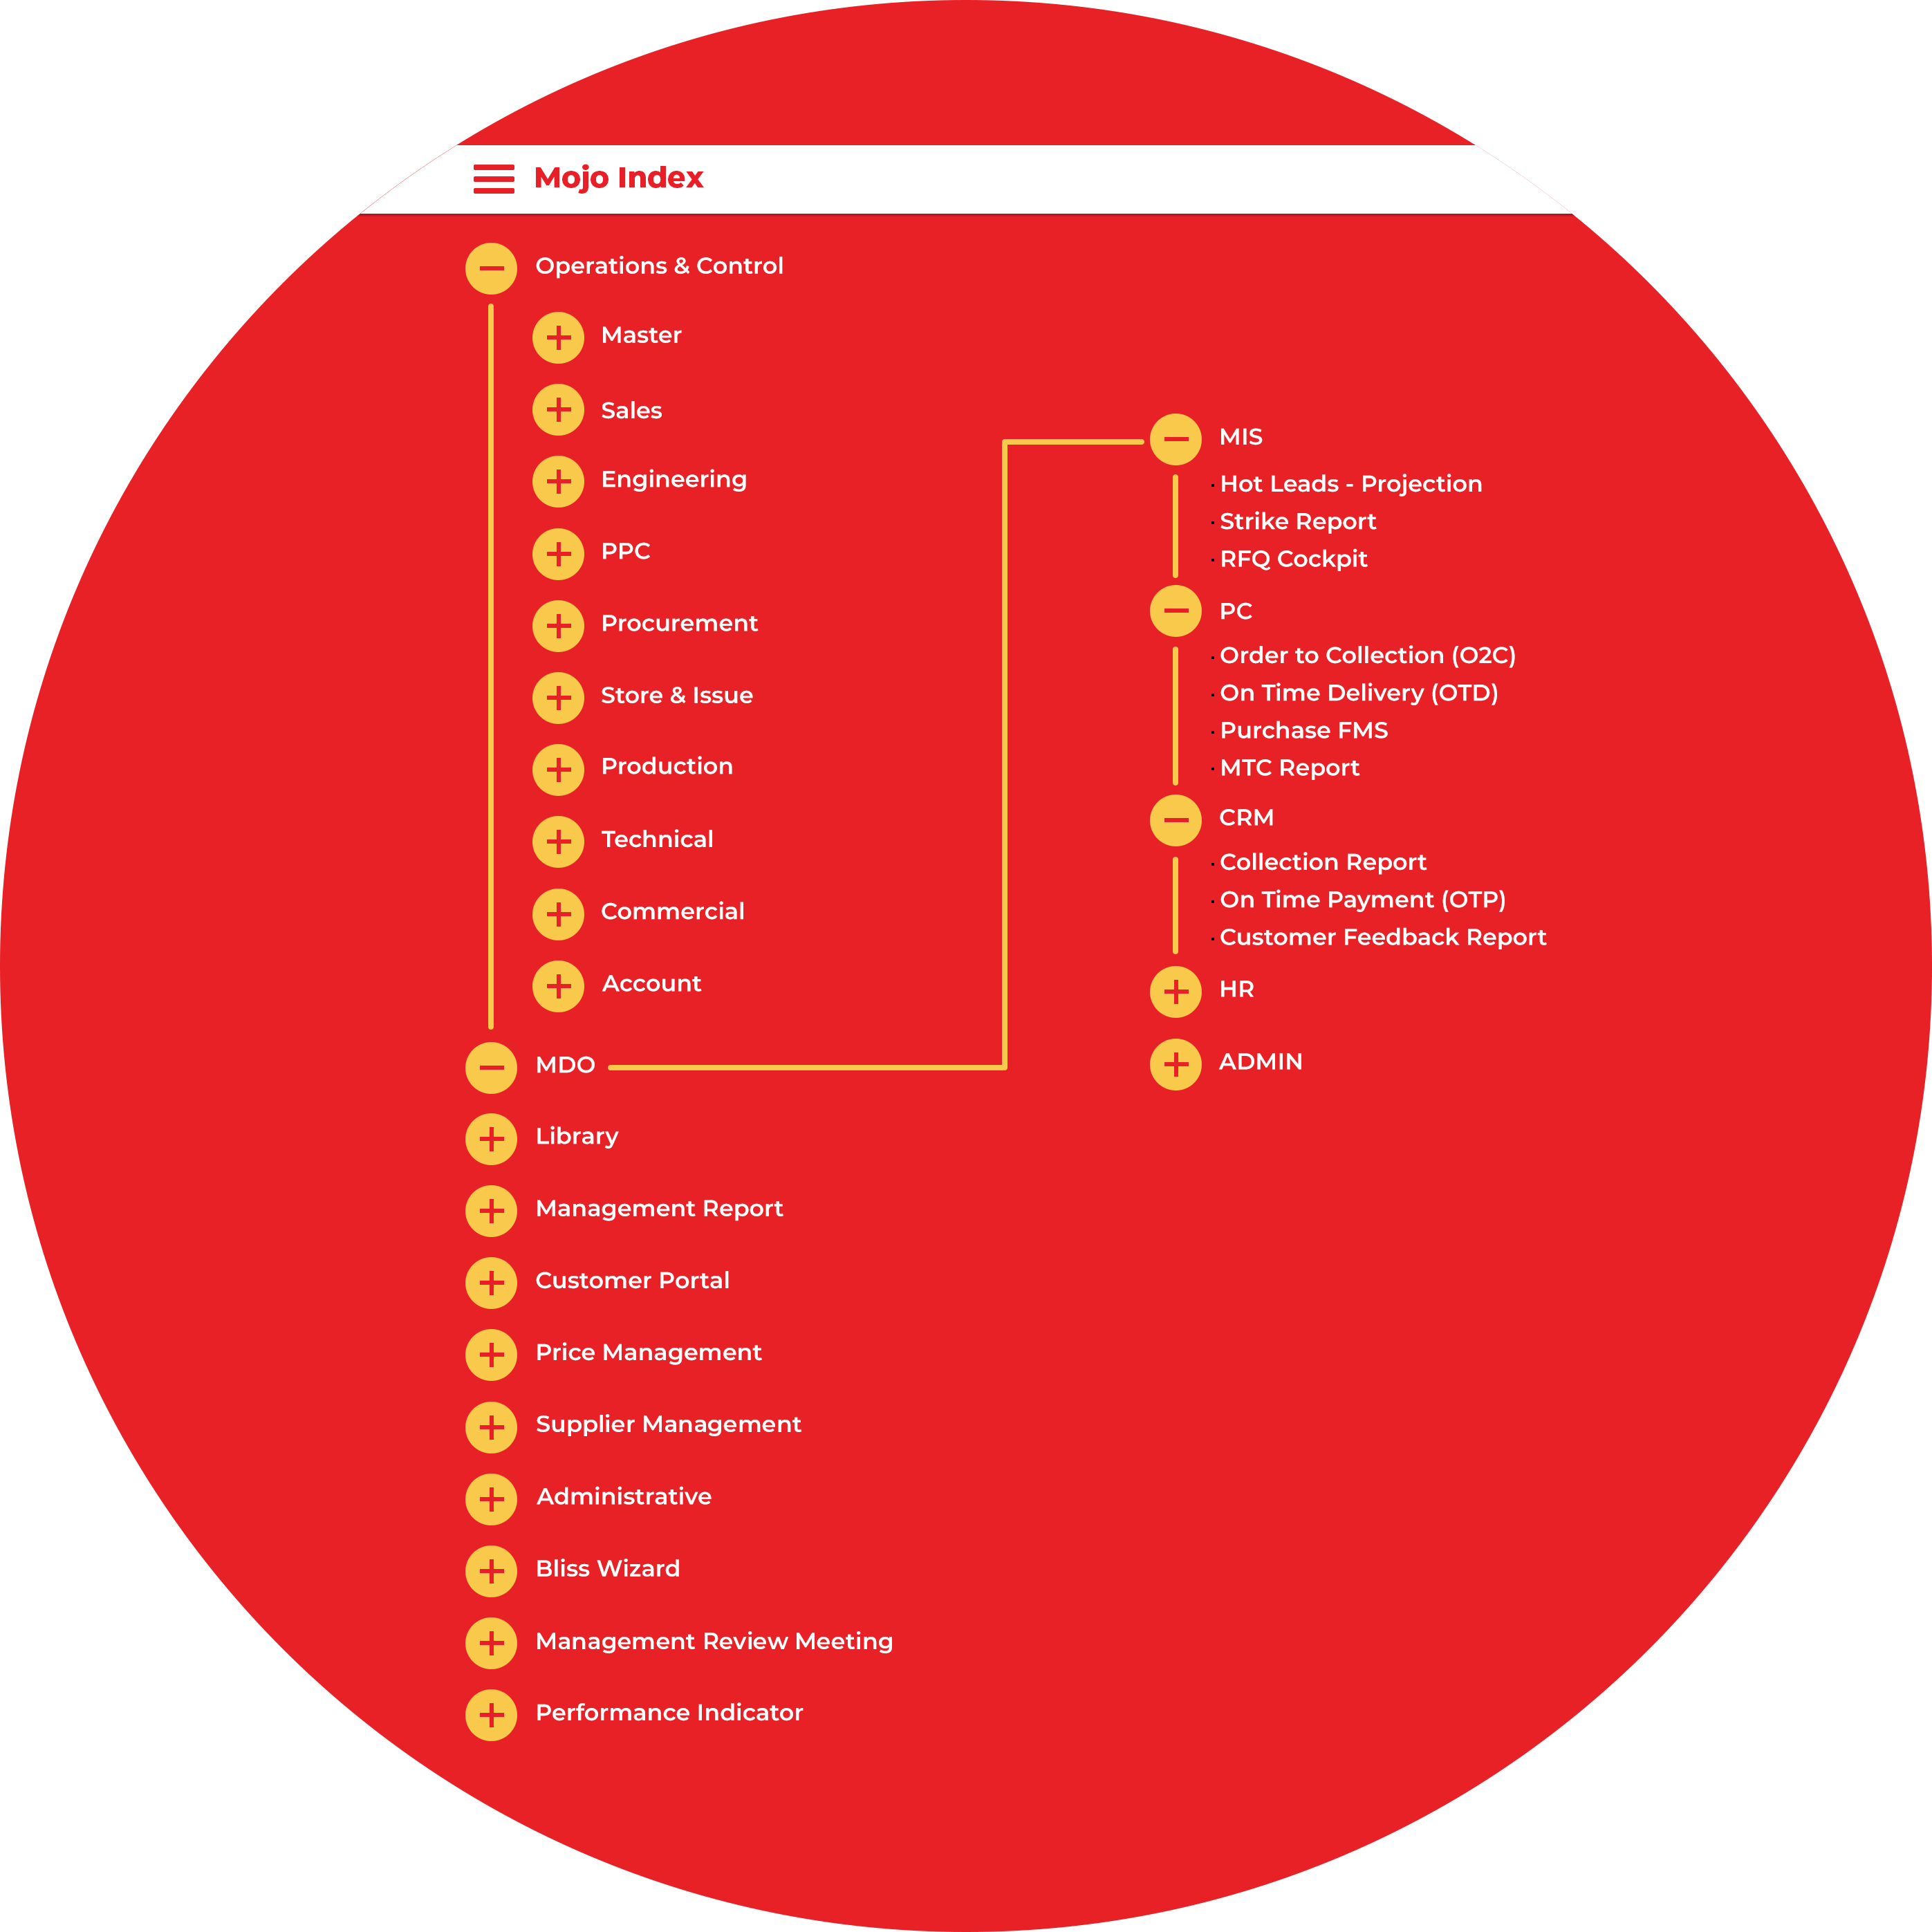
Mojo Index
www.mojoamericas.com

Slide 5
Mojo help sales reps and managers alike streamline their workflows and track leads to improve sales processes. Sales department includes following forms and modules:
Sales Department

Slide 6
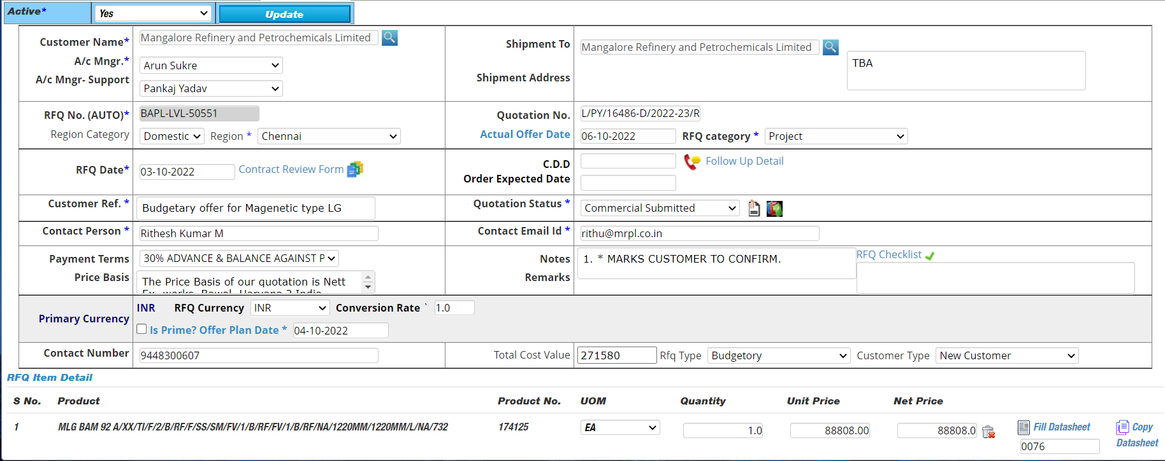
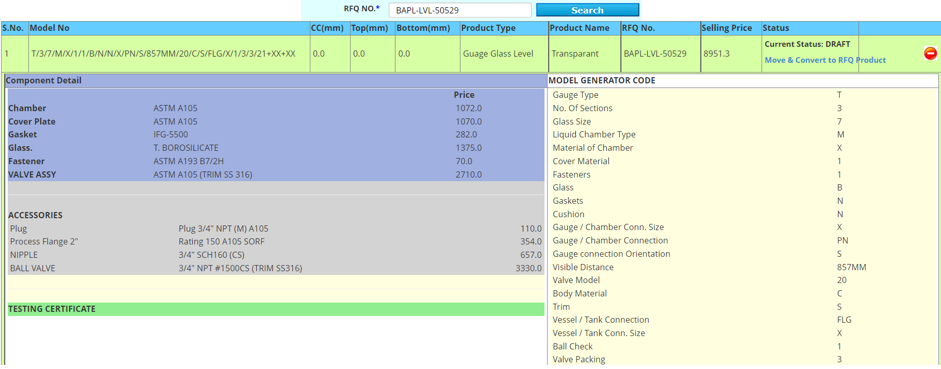
A. Request For Quote (RFQ) Form
B. Pricing Module (Auto calculation as per standard inputs)
www.mojoamericas.com

Slide 7
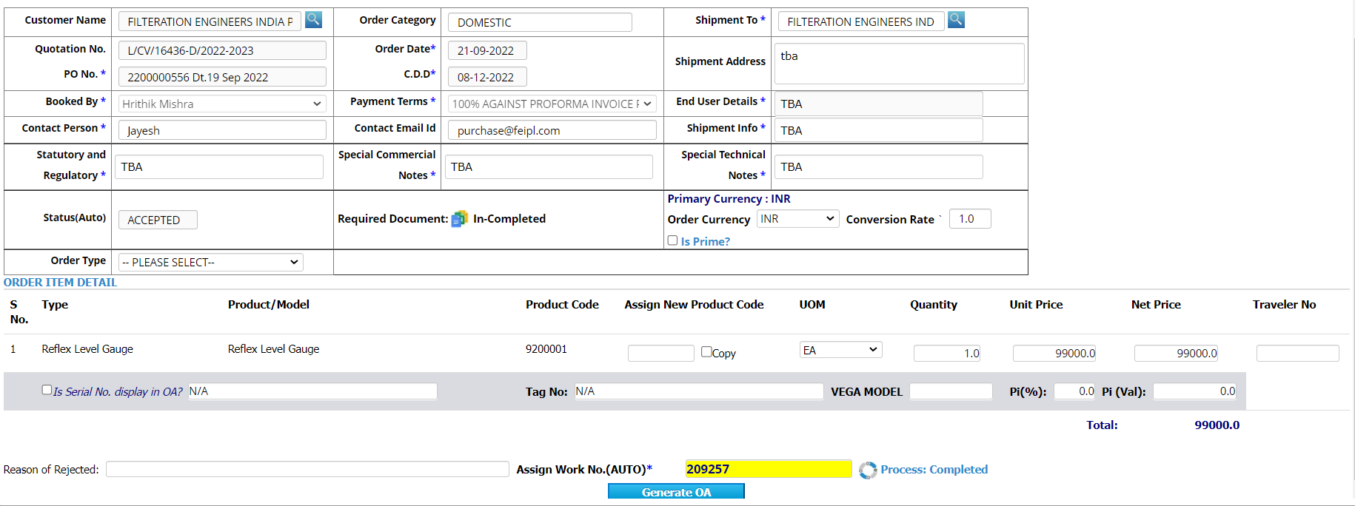
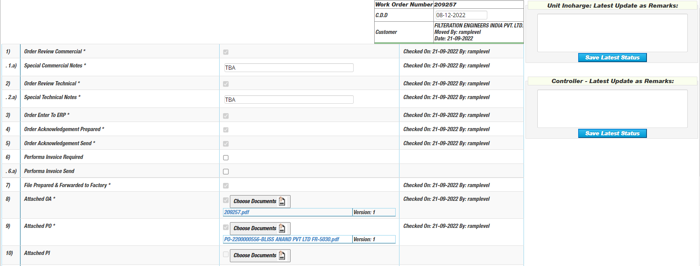
C. Order Form
D. Sales Department Checklist
www.mojoamericas.com

Slide 8
E. Performa Invoice (PI) Module
F. ABG Module
G. PBG Module
H. Target set of Each Work Order Module
www.mojoamericas.com

Slide 9
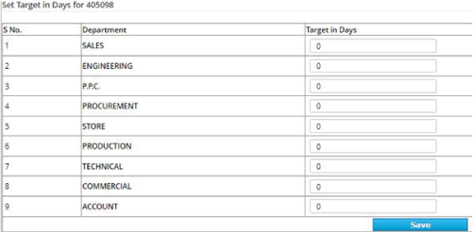
I. Order to Collection (O2C) Report
Track your orders Planned Vs Actual Days for each department
Plan target for all Order of each department
O2C Report (Order to Collection) - Days Captured
www.mojoamericas.com

Slide 10
Mojo Americas system includes the detail engineering database cover of your business. Engineering department includes following forms and modules:
Engineering Department

Slide 11
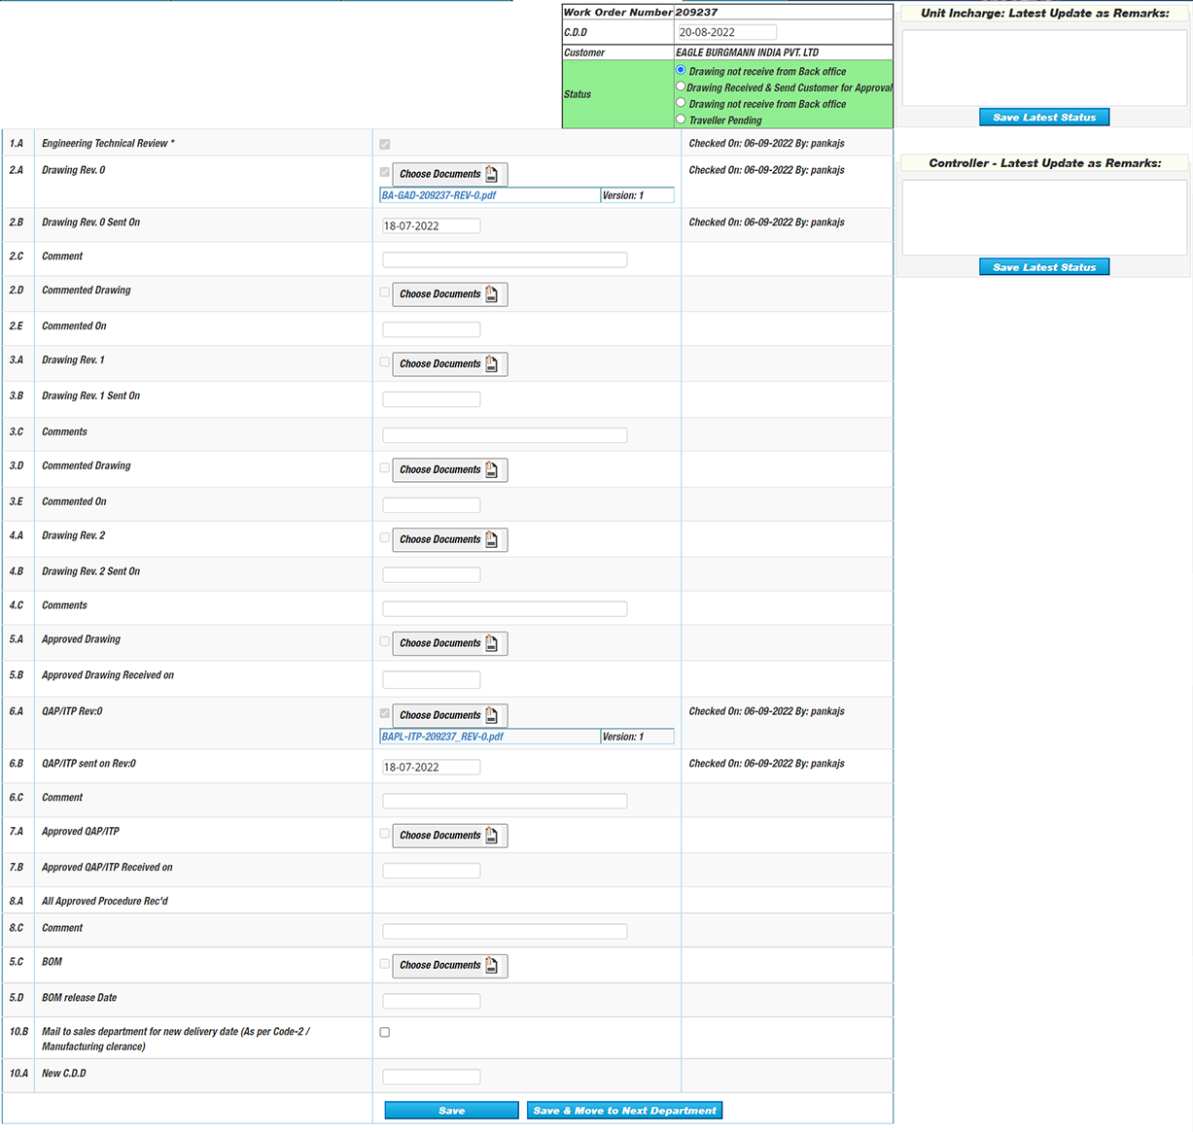
A. Engineering Department Checklist
www.mojoamericas.com

Slide 12
B. Bill Of Material (BOM) Module
www.mojoamericas.com

Slide 13
PPC Department
Mojo Americas system provide the checklist of each work order for PPC department which are below:
www.mojoamericas.com

Slide 14
Procurement Department
Mojo Americas help to track all Supplier Purchase Order (SPO) through Purchase FMS module. In addition mojo provides the Order wise checklist and SPO form to generate PDF and share with vendor. Procurement department includes following forms and modules:
A. Procurement Department Checklist
www.mojoamericas.com

Slide 15
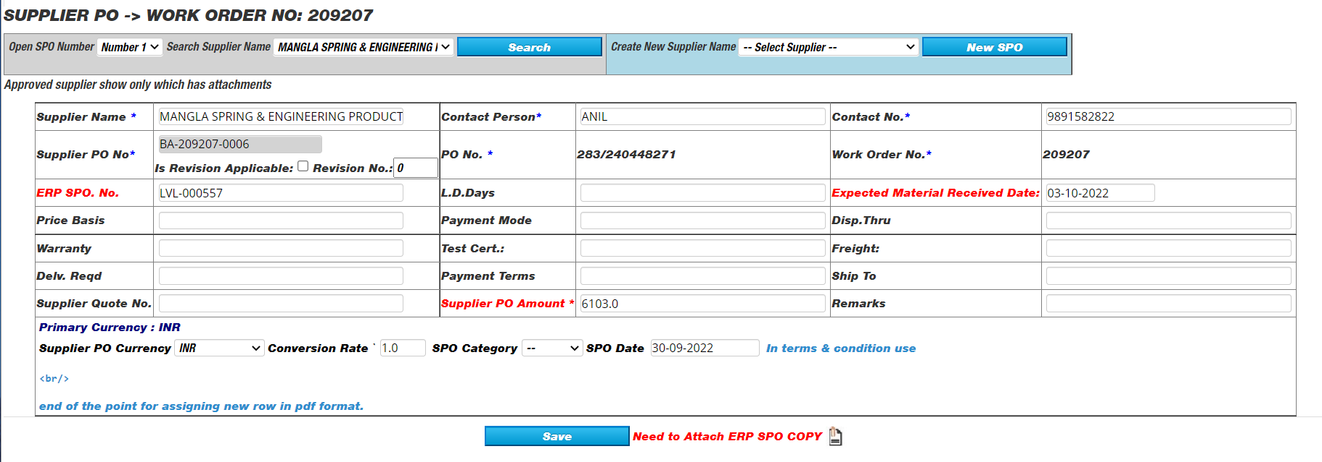
B. SPO Form
C. Inward Freight
www.mojoamericas.com

Slide 16
Store
Department

Slide 17
A. Store Checklist
B. MTC Form
www.mojoamericas.com

Slide 18
Production Department
Production Checklist
www.mojoamericas.com

Slide 19
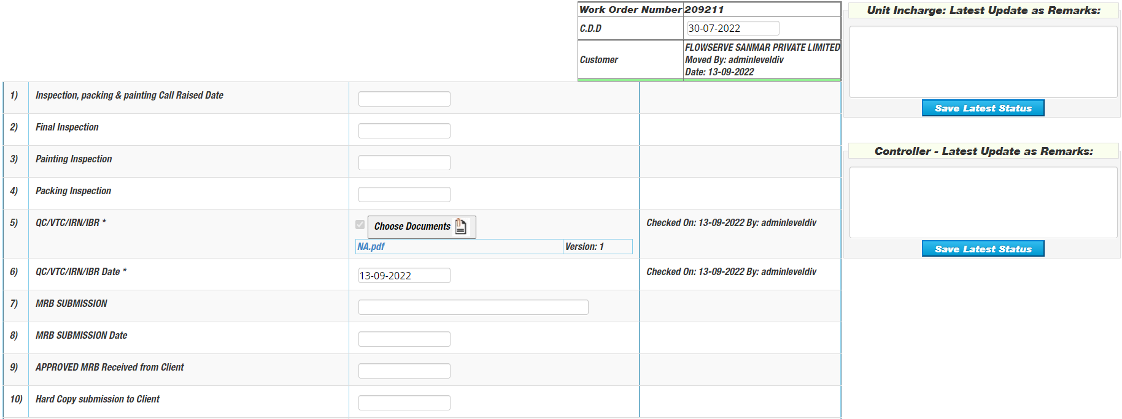
Technical Department Department
www.mojoamericas.com

Slide 20
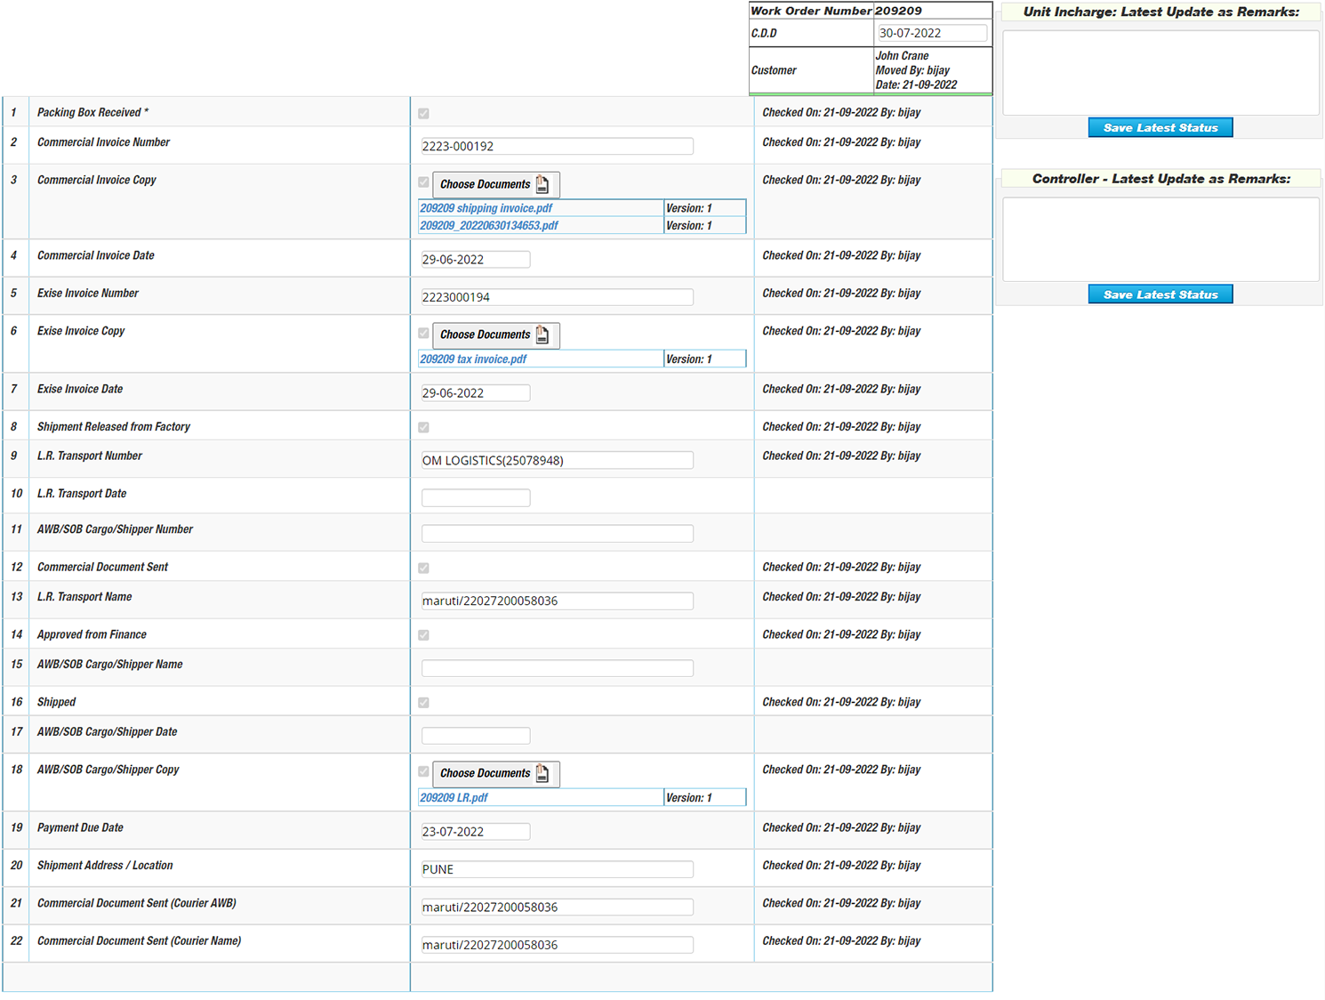
Commercial Department
www.mojoamericas.com

Slide 21
Accounts Department
www.mojoamericas.com

Slide 22
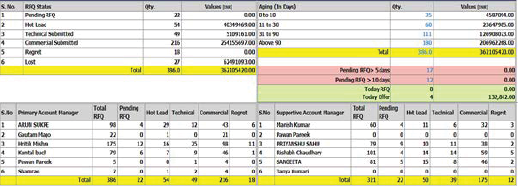
Sales Funnel/Enquiry Capture Report
www.mojoamericas.com

Slide 23
Hot Leads Tracking RSM (Regional Sales Manager)
www.mojoamericas.com

Slide 24
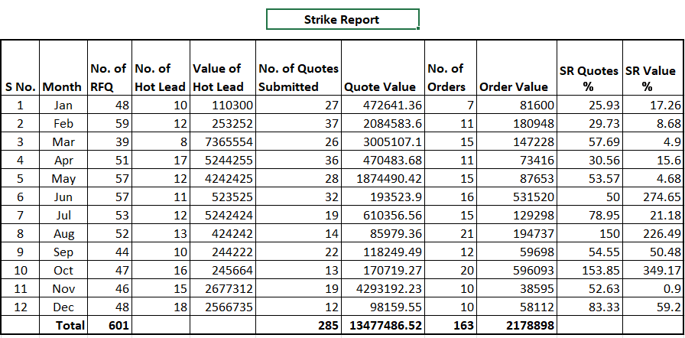
Strike Report
www.mojoamericas.com

Slide 25
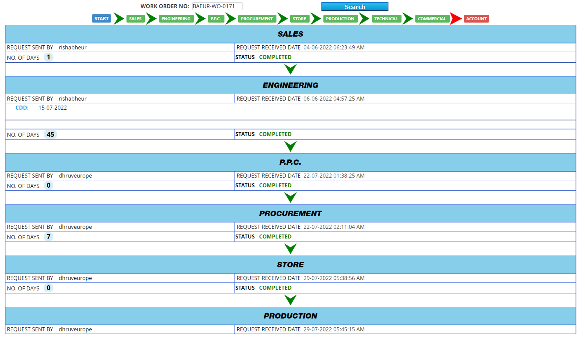
Order Wise Tracking Report
www.mojoamericas.com

Slide 26
Mojo Americas
Thanks!
www.mojoamericas.com

